Slide 1

Introduction to Dynamic Programming
Prof. Jaroslav Sklenar
15.4.2014
This lecture is supported by project No. CZ.1.07/2.2.00/28.0062 „Joint activities of BUT and VSB-TUO while creating the content of accredited technical courses in ICT “

Slide 2

Jaroslav Sklenář e-mail: jaroslav.sklenar@um.edu.mt web: http://staff.um.edu.mt/jskl1/
University of Malta
Faculty of Science
Department of Statistics & Operations Research

Slide 3

Introduction to Dynamic Programming
“Dividae at impera”
Roman Empire, 400-300 B.C., author unknown, wording probably not ancient.

Slide 4
Dynamic Programming
Basic ideas
Specification of common features
Mathematical model
DP algorithm
Stochastic DP with Finite Horizon
Examples

Slide 5
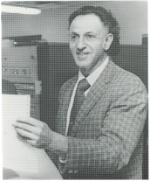
Dynamic Programming
History:
Richard Bellman (1920-1984)
Fundamental Book:
Bellman,R. (1957) Dynamic Programming, Princeton Univ. Press
Dynamic: "… the adjective indicates that we are interested in processes in which time plays a significant role,… however an essential feature is reinterpretation of static processes as dynamic processes in which time can be artificially introduced".
Programming: " … to use a terminology now popular."

Slide 6
Dynamic Programming
History:
Richard Bellman (1920-1984)
Principal of Optimality (1953)
"For every stage and every decision that starts an optimal plan from this stage, the optimal plan consists of the given decision followed by the plan which is optimal with respect to the succeeding stage".
"Every optimal solution can only be formed by partial optimal solutions".
"To solve stage t we can consider only optimal decisions at stage t + 1".

Slide 7
Dynamic Programming
Selected Definitions:
"Dynamic programming is concerned with the solution of optimisation problems which can be formulated as a sequence of decisions" (Hastings, 1973)
"Dynamic programming is an optimization technique ... of solving or simplifying problems through the application of the principle of optimality" (Norman, 1975)
"Dynamic programming is the collection of mathematical tools used to analyze sequential decision processes"
(Denardo, 1982)
"Dynamic programming is not an algorithm. It is rather a general principle applicable to many constrained optimization problems... " (Minoux, 1986; Sniedovich, 1992)

Slide 8
Dynamic Programming
Basic Idea – shortest path problem
DP Solution:
7
D
B
5
9
3
A
F
8
3
2
C
E
5

Slide 9
Dynamic Programming
Basic Idea – shortest path problem
DP Solution:
Identify decision stages and states
7
D
B
5
9
3
A
F
8
3
2
C
E
5

Slide 10
Dynamic Programming
Basic Idea – shortest path problem
I II III
DP Solution:
Identify decision stages and states
7
D
B
5
9
3
A
F
8
3
2
C
E
5

Slide 11
Dynamic Programming
Basic Idea – shortest path problem
I II III
DP Solution:
Identify decision stages and states
Solve all states by:
- computing objective for all decisions
- selecting the optimal objective value
- saving the optimal objective and all optimal decisions
for each state
7
D
B
5
9
3
A
F
8
3
2
C
E
5

Slide 12
Dynamic Programming
Basic Idea – shortest path problem
I II III
DP Solution:
Identify decision stages and states
Solve all states by:
- computing objective for all decisions
- selecting the optimal objective value
- saving the optimal objective and all optimal decisions
for each state
7
D
B
5
9
3
5
A
F
8
3
2
C
E
5

Slide 13
Dynamic Programming
Basic Idea – shortest path problem
I II III
DP Solution:
Identify decision stages and states
Solve all states by:
- computing objective for all decisions
- selecting the optimal objective value
- saving the optimal objective and all optimal decisions
for each state
7
D
B
5
9
3
5
A
F
3
2
8
2
C
E
5

Slide 14
Dynamic Programming
Basic Idea – shortest path problem
I II III
DP Solution:
Identify decision stages and states
Solve all states by:
- computing objective for all decisions
- selecting the optimal objective value
- saving the optimal objective and all optimal decisions
for each state
7
D
B
5
9
5
3
5
A
F
3
2
8
2
C
E
5

Slide 15
Dynamic Programming
Basic Idea – shortest path problem
I II III
DP Solution:
Identify decision stages and states
Solve all states by:
- computing objective for all decisions
- selecting the optimal objective value
- saving the optimal objective and all optimal decisions
for each state
7
D
B
5
9
5
3
5
A
F
7
3
2
8
2
C
E
5

Slide 16
Dynamic Programming
Basic Idea – shortest path problem
I II III
DP Solution:
Identify decision stages and states
Solve all states by:
- computing objective for all decisions
- selecting the optimal objective value
- saving the optimal objective and all optimal decisions
for each state
7
D
B
5
14
9
5
3
5
A
F
7
3
2
8
2
C
E
5

Slide 17
Dynamic Programming
Basic Idea – shortest path problem
I II III
Common Features of DP Solutions:
- Existence of decision stages and states
7
D
B
5
14
9
5
3
5
A
F
7
3
2
8
2
C
E
5

Slide 18
Dynamic Programming
Basic Idea – shortest path problem
I II III
Common Features of DP Solutions:
- Existence of decision stages and states
- Memoization (using results already obtained)
7
D
B
5
14
9
5
3
5
A
F
7
3
2
8
2
C
E
5

Slide 19
Dynamic Programming
Basic Idea – shortest path problem
I II III
Common Features of DP Solutions:
- Existence of decision stages and states
- Memoization (using results already obtained)
- Embedding (existence of a family of related similar problems)
7
D
B
5
14
9
5
3
5
A
F
7
3
2
8
2
C
E
5

Slide 20
Dynamic Programming
- Embedding (existence of a family of related similar problems)
7
D
B
5
14
9
5
3
5
A
F
7
3
2
8
2
C
E
5

Slide 21
Dynamic Programming
- Embedding (existence of a family of related similar problems)
7
D
B
5
14
9
5
3
5
A
F
7
3
2
8
2
C
E
5

Slide 22
Dynamic Programming
Embedding (existence of a family of related similar problems)
(here we solve 5 shortest path problems)
7
D
B
5
14
9
5
3
5
A
F
7
3
2
8
2
C
E
5

Slide 23
Dynamic Programming
Principles
Existence of decision stages and states
Embedding (existence of a family of related similar problems)
Memoization (using results already obtained)
Wikipedia: "memoization is an optimization technique used primarily to speed up computer programs by having function calls avoid repeating the calculation of results for previously-processed inputs".
Derived from Latin "memorandum" (to be remembered).

Slide 24
Dynamic Programming
Multistage Decision Model:
Stages t ∈ {1 … T } where T is the number of stages
Set of states for each stage: y_{t} ∈ Y_{t}
Set of decisions for each stage-state pair (t, y_{t}):
x_{t} ∈ X_{t}(y_{t})
Transition function y_{t+1} = g_{t}(x_{t} ,y_{t} )
Initial state y₁ defines the problem instance
Functional equation giving optimal objective for each stage-state pair (t, y_{t}):

Slide 25
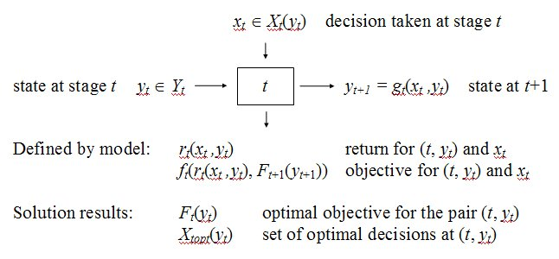
Dynamic Programming
Multistage Decision Model: stage t graphically

Slide 26






Dynamic Programming
Multistage Decision Model: forms of f_{t}
Generally:
Return defined:
Additive objective:
Additive discounted:
Multiplicative:
Min(Max):
All forms represent separability

Slide 27
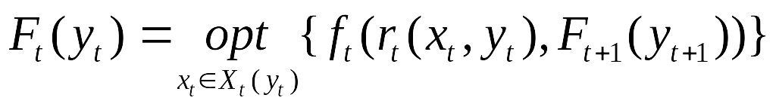
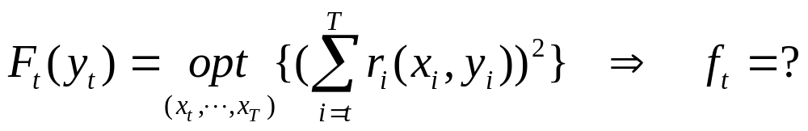
Dynamic Programming
Multistage Decision Model
Counterexample to separability:

Slide 28
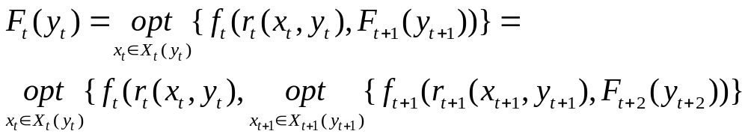
Dynamic Programming
Multistage Decision Model
Algebraical form of optimality:
Simplified notation assuming separability:

Slide 29
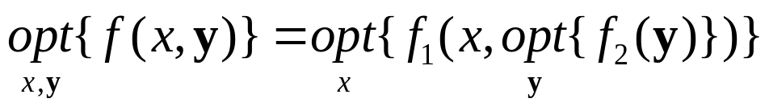
Dynamic Programming
Multistage Decision Model: decomposable functions
Definition: We say that a real valued multivariate function f is decomposable into f₁ and f₂ if f is separable:
f (x,y) = f₁(x,f₂(y)) and if moreover the function f₁ is monotone non-decreasing relative to second argument.
Theorem: Let f be a real valued multivariate function decomposable into f₁ and f₂ with f (x,y) = f₁(x,f₂(y)). Then the following equality holds:
Proof: contact me

Slide 30
Dynamic Programming
Multistage Decision Model: is decomposability sufficient ?
Principal of optimality ≡ ?
Counterexample:
both plans optimal, F₁=9
3
7
9
4
5

Slide 31
Dynamic Programming
Multistage Decision Model: is decomposability sufficient ?
Principal of optimality ≡ ?
Counterexample:
both plans optimal, F₁=9
Optimal decision followed by a not optimal plan !
3
7
9
4
5

Slide 32
Dynamic Programming
Multistage Decision Model: strict decomposability
Definition: We say that a real valued multivariate function f is decomposable in the strict sense if f is separable:
f (x,y) = f₁(x,f₂(y)) and if moreover the function f₁ is strictly increasing relative to its second argument:
z₁ < z₂ ⇒ f₁(x,z₁) < f₁(x,z₂), ∀x
z₁ = z₂ ⇒ f₁(x,z₁) = f₁(x,z₂), ∀x
Result: for strictly decomposable functions the principal of optimality is satisfied.
Note: opt{x,y}, x+by, xy are not strictly decomposable generally; x+y is.

Slide 33
Dynamic Programming
Counterexample to optimality:
3 (x=3)
4 (x=4)
t
t+1
6 (x=2)
x
3 (x=3)
4 (x=4)
t
t+1
6 (x=2)

Slide 34
Dynamic Programming
Multistage Decision Model: backward procedure algorithm
Evaluate function F_{T+1}(y_{T+1}) for all terminal states.
For t = T down to 1 evaluate the stage t by using the functional equation for all relevant states y_{t} and decisions x_{t}. For each decision x_{t} perform steps:
    - evaluate g_{t} to obtain y_{t+1}
    - retrieve F_{t+1}(y_{t+1})
    - evaluate f_{t}.
For each state y_{t} store the optimal value F_{t}(y_{t}) and the associated set of optimal decisions X_{topt}(y_{t}). The value F₁(y₁) is the optimal objective value.
Retrieve recursively the set of optimal solutions X_{opt}(y₁) = {x_{opt}} = {(x₁, x₂, ... x_{T})} such that x₁ ∈ X_{1opt}(y₁) and x_{t} ∈ X_{topt}(y_{t}), y_{t} = g_{t-1}(y_{t-1}, x_{t-1}) for t = 2 ... T.

Slide 35
Dynamic Programming
Multistage Decision Model: retrieving optimal solutions
1
T
Rule: follow the left path, delete last branching

Slide 36
Dynamic Programming
Multistage Decision Model: retrieving optimal solutions
1
T

Slide 37
Dynamic Programming
Multistage Decision Model: retrieving optimal solutions
1
T

Slide 38
Dynamic Programming
Multistage Decision Model: retrieving optimal solutions
1
T
Disconnected root ends the generation

Slide 39
Performance of DP algorithm
Assumptions:
n = number of stages
N = maximum number of states per stage (?)
K = maximum number of decisions per state
DP:
step = evaluate r , add F , compare
number of steps = nNK, performance O(n)
Full enumeration:
NK^{n} paths, step = evaluate r , add
Number of steps = nNK^{n} , performance O(nk^{n})

Slide 40
Performance of DP algorithm
Example of an NP hard DP solution.
Travelling Salesman:
stage = number of visited vertices(t =1..n)
state = (v_{t} ,V_{t})
v_{t} = vertex considered
V_{t} = set of vertices to be still visited
Number of states grows exponentially with n !
DP: Converts an NP hard solution to a polynomial one.
Still NP hard, but size of soluble instances increased.

Slide 41
Dynamic Programming & Optimization
Optimization
Dynamic Programming

Slide 42
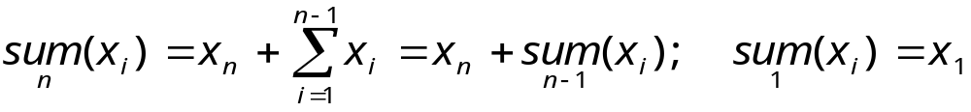
Dynamic Programming & Optimization
Optimization
Dynamic Programming
Stages & Embedding:

Slide 43
Dynamic Programming & Optimization
Optimization
Dynamic Programming
Stages & Embedding:

Slide 44
Dynamic Programming & Optimization
Memoization?
function fn = fibonacci1(n)
if n<=0 fn = 0;
elseif n==1 fn = 1;
else
f(1) = 0; f(2) = 1;
for i=2:n
f(i+1) = f(i)+f(i-1);
end
fn = f(n+1);
end
Time = 0.03s for
F(1476) ≈ 1.306989e+308
function fn = fibonacci2(n)
if n<=0 fn = 0;
elseif n==1 fn = 1;
else
fn = fibonacci2(n-1)
+ fibonacci2(n-2);
end
Time:
n | time[s]
15 | 0.06
20 | 0.44
30 | 53.7
35 | 583.47

Slide 45
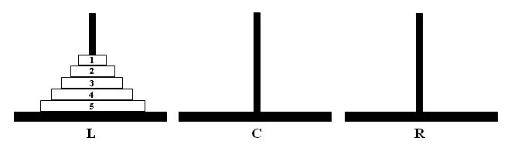
Tower(s) of Hanoi (Edouard Lukas, 1883)
Problem: move the tower from L to R by these rules:
- move only one disk at a time
- a disk can be placed on an empty platform or a bigger disk

Slide 46
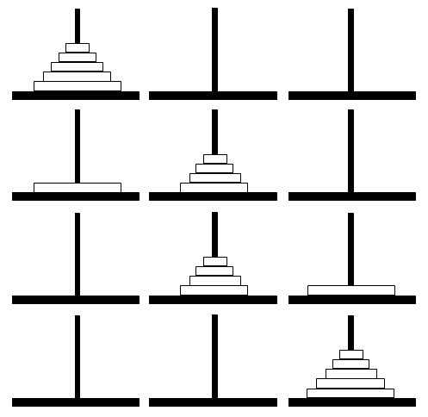
Optimal solution:

Slide 47
Matlab solution
function hanoi(n,from,to,using)
if n>0
hanoi(n-1,from,using,to);
display(['Move disk ' int2str(n) ' from ' from ' to ' to]);
hanoi(n-1,using,to,from);
end
>> hanoi(3,'L','R','C')
Move disk 1 from L to R
Move disk 2 from L to C 2 disks move
Move disk 1 from R to C
Move disk 3 from L to R
Move disk 1 from C to L
Move disk 2 from C to R 2 disks move
Move disk 1 from L to R

Slide 48
Problem 1: Number of moves of the optimal solution
B(n) = number of moves
to solve the problem
of size n in the best
way
B(n) = 2B(n-1) + 1, n>1 B(1) = 1
Results in:
B(n) = 2^{n} – 1,n = 1,2,...

Slide 49
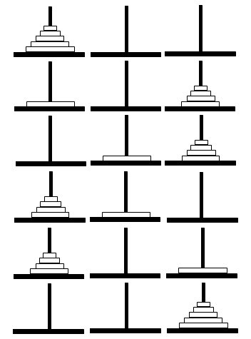
Problem 2: Number of moves of the worst solution
W(n) = number of moves
to solve the problem
of size n in the worst
way
W(n) = 3W(n-1) + 2, n>1 W(1) = 2
Results in:
W(n) = 3^{n} – 1,n = 1,2,...

Slide 50
Problem 3: Number of different solutions
F(n) = number of diferent (nonrepeating) ways
to solve the problem of size n
F(n) = F(n-1)² + F(n-1)³,n>1 F(1) = 2
F(2) = 12, F(3) = 1872
F(4) = 6,563,711,232
F(5) ≈ 2.827798101718050e+029

Slide 51
Dynamic Programming & Optimization
Optimization
Dynamic Programming

Slide 52
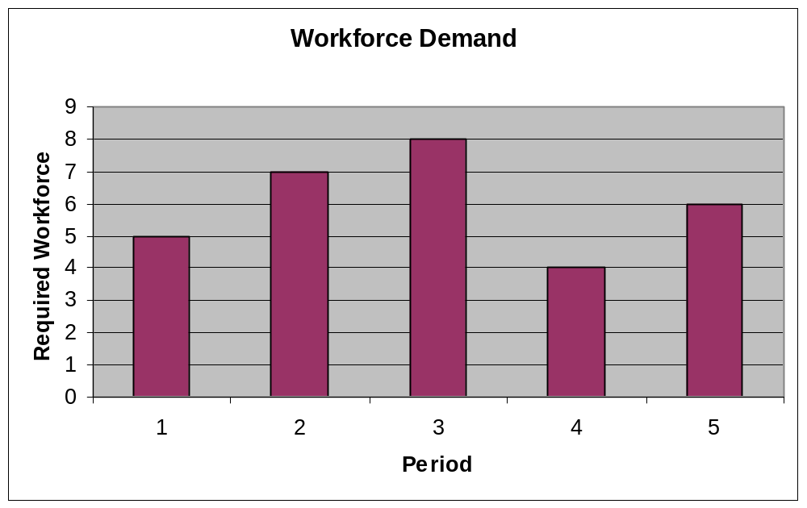
Deterministic Optimization Example
Example application: workforce allocation problem
Demand (b_{t}) must be satisfied, excess cost = 300/worker, hiring cost = 400+200/worker, no severance, optimal plan required.

Slide 53
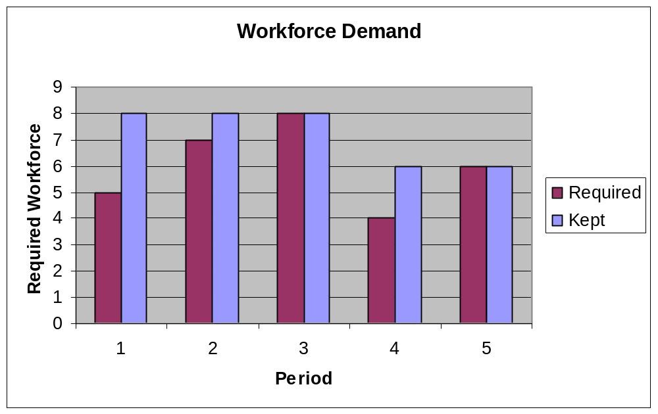
Deterministic Optimization Example
Example application: workforce allocation problem
Minimal and maximal plans.

Slide 54
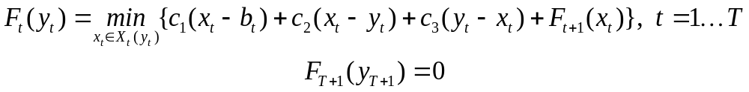
Deterministic Optimization Example
Example application: workforce allocation problem
DP Model:
1. Stages stage = period t ∈ {1 … T }
2. States state y_{t} = number of workers from the previous period.
Y_{t} = {b_{t-1}, … , max(b_{t-1}, b_{t} , b_{t+1}, … , b_{T})}, t = 2 … T
3. Decisions decision x_{t} = number of workers kept at period t.
X_{t}(y_{t}) = {b_{t} , … , max(b_{t} , b_{t+1}, … , b_{T})}, t = 1 … T
4. Transition function g_{t}(x_{t} ,y_{t}) = x_{t}
5. Initial state y₁ = number of workers initially available.
6. Functional equation (c₁ c₂ c₃ are excess, hiring and firing cost fun.)

Slide 55
Deterministic Optimization Example
Table
solution:
(x 100)
t | y_{t} | x_{t} | r_{t} | f_{t} | y_{t+1}
5 | 4 5 6 | 6 6 6 | 4+4 4+2 0 | 8 6 0 | 6 6 6
4 | 8 | 4 5 6 | 0 3 6 | 8 9 6 | 4 5 6
3 | 7 8 | 8 8 | 4+2 0 | 12 6 | 8 8
2 | 5 6 7 8 | 7 8 7 8 7 8 7 8 | 4+4 4+6+3 4+2 4+4+3 0 4+2+3 0 3 | 20 19 18 17 12 15 12 9 | 7 8 7 8 7 8 7 8
1 | 0 | 5 6 7 8 | 4+10 4+12+3 4+14+6 4+16+9 | 33 36 46 38 | 5 6 7 8

Slide 56
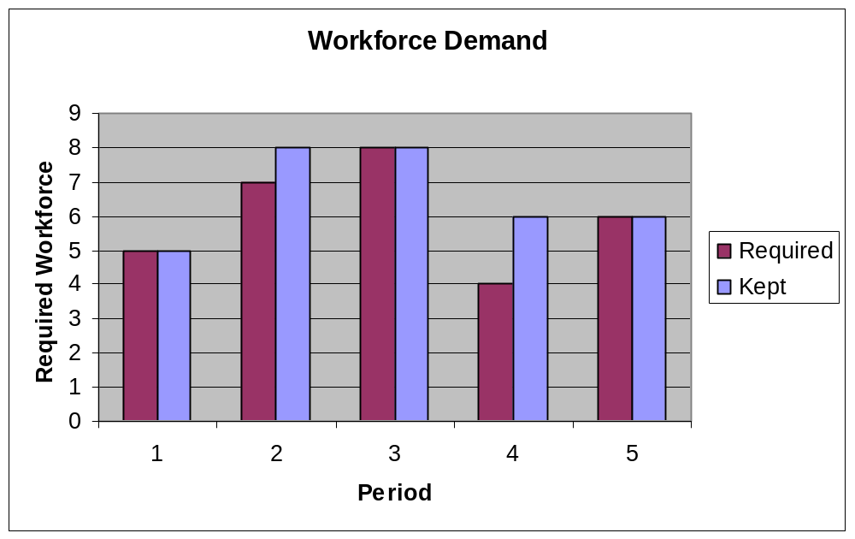
Deterministic Optimization Example
Example application: workforce allocation problem
Optimal plan, total cost = 3300

Slide 57
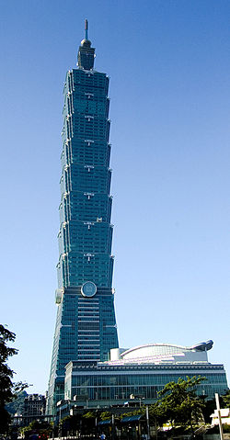

Deterministic Optimization Example
Egg dropping problem:
© Wikipedia

Slide 58
Deterministic Optimization Example
Egg dropping problem:
© Wikipedia

Slide 59

Deterministic Optimization Example
Egg dropping problem:
© Wikipedia

Slide 60
Deterministic Optimization Example
Egg dropping problem:
Problem:
Given a number of same eggs, find the critical floor c (such that an egg doesn’t break from floor c, but breaks from floor c+1) in minimum number of trials.
© Moshe Sniedovich
University of Melbourne
© Wikipedia

Slide 61
Deterministic Optimization Example
Egg dropping problem – Worst Case Scenario
Mother Nature is:
Hostile – it will try to maximize our number of trials

Slide 62
Deterministic Optimization Example
Egg dropping problem – Worst Case Scenario
Mother Nature is:
Hostile – it will try to maximize our number of trials
Intelligent – it always finds the worst solution for us

Slide 63
Deterministic Optimization Example
Egg dropping problem – Worst Case Scenario
Mother Nature is:
Hostile – it will try to maximize our number of trials
Intelligent – it always finds the worst solution for us
Fair – it will not cheat

Slide 64
Deterministic Optimization Example
Egg dropping problem – Worst Case Scenario
Notation:
n = number of eggs
h = height of the building (number of floors)
c = critical floor 0 ≤ c ≤ h
k = floors to be checked, initially k =h
W(n,k) = minimum number of trials to solve a problem of the size (n,k)
x = decision variable 1 ≤ x ≤ k (when solving an (n,k) problem we drop an egg from floor x)

Slide 65
Deterministic Optimization Example
Egg dropping problem – Worst Case Scenario
DP solution:
Decision stage = trial

Slide 66
Deterministic Optimization Example
Egg dropping problem – Worst Case Scenario
DP solution:
Decision stage = trial
Embedding - degenerate cases:
W(n,1) = 1 (one floor to be checked), also W(n,0) = 0
W(1,k) = k (with one egg we have to check all floors starting from 1 and the hostile Nature will let us to check them all)

Slide 67
Deterministic Optimization Example
Egg dropping problem – Worst Case Scenario
DP solution:
Embedding - nondegenerate cases:
After a trial at floor x for an (n,k) problem there are two outcomes:
Egg broken: we then solve a problem (n -1,x -1)
Egg not broken: we then solve a problem (n,k -x)
Nature selects the bigger value that we minimize over x :

Slide 68
Deterministic Optimization Example
No memoization:
function y = eggRecw(n,k)
if k == 0 y = 0;
elseif k==1 y = 1;
elseif n == 1
y = k;
else
y = k;
for x=1:k
y = min(y,max(eggRecw(n-1,x-1),
eggRecw(n,k-x)));
end
y = 1 + y;
end
Time:
problem | time[s]
(2,15) | 0.92
(3,15) | 6.81
(2,16) | 1.86
(3,17) | 30.98
(4,18) | 277.7
(4,19) | 652.3

Slide 69
Deterministic Optimization Example
Memoization:
Time:
function [fopt,W] = eggDirect(N,H)
for n=1:N
W(n,1) = 0; % column for k=0
for k=1:H
if k==1 W(n,k+1) = 1;
elseif n==1 W(n,k+1) = k;
else
y = k;
for x=1:k
y = min(y,max(W(n,k-x+1),W(n-1,x)));
end
W(n,k+1) = 1 + y;
end
end end
fopt = W(N,H);
problem | time[s]
(2,15) | 0
(4,18) | 0
(10,50) | 0
(10,500) | 0.11
(50,1000) | 1.98
(50,10000)* | 204.4
* result = 14 trials

Slide 70
Deterministic Optimization Example
Some (surprising) results:
>> eggDirectws(3,93,1)
Optimal policy:
Drop from floor 1 : Egg not broken
Drop from floor 30 : Egg broken
Drop from floor 8 : Egg broken
Drop from floor 2 : Egg not broken
Drop from floor 3 : Egg not broken
Drop from floor 4 : Egg not broken
Drop from floor 5 : Egg not broken
Drop from floor 6 : Egg not broken
Drop from floor 7 : Egg broken
Critical floor C = 6
Minimal number of trials = 9

Slide 71
Deterministic Optimization Example
Some (surprising) results:
>> eggDirectws(5,500,1)
Optimal policy:
Drop from floor 119 : Egg not broken
Drop from floor 282 : Egg broken
Drop from floor 183 : Egg broken
Drop from floor 141 : Egg broken
Drop from floor 125 : Egg broken
Drop from floor 120 : Egg not broken
Drop from floor 121 : Egg not broken
Drop from floor 122 : Egg not broken
Drop from floor 123 : Egg not broken
Drop from floor 124 : Egg broken
Critical floor C = 123
Minimal number of trials = 10

Slide 72
Deterministic Optimization Example
Patterns in objective and optimal decisions:
>>[f W X] = eggDirectws(3,20,0)
f = 5
W = 1 2 3 4 5 6 7 8 9 10 11 12 13 14 15 16 17 18 19 20
1 2 2 3 3 3 4 4 4 4 5 5 5 5 5 6 6 6 6 6
1 2 2 3 3 3 3 4 4 4 4 4 4 4 5 5 5 5 5 5
X = 1 1 1 1 1 1 1 1 1 1 1 1 1 1 1 1 1 1 1 1
1 1 2 1 2 3 1 2 3 4 1 2 3 4 5 1 2 3 4 5
1 1 2 1 2 3 4 1 2 3 4 5 6 7 1 2 3 4 5 6

Slide 73
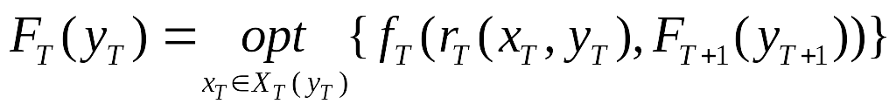
Dynamic Programming
Multistage Decision Model: notes
1) Evaluation of F_{T}:
We introduce a terminal stage T+1 with F_{T+1} defined (mostly trivially, often 0).
2) Solution to critical stage (mostly 1) solves the original problem.

Slide 74
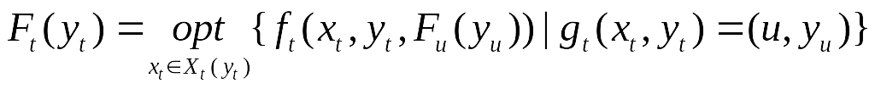
Dynamic Programming
Multistage Decision Model: notes
3) Generalization to progressive cases (skipping stages):
Transition function: g_{t}(x_{t} ,y_{t} ) = (u,y_{u}), u = next stage
4) Generalization to vector states: y_{t} → y_{t}
Egg: state =(n,k) = (number of eggs, number of floors)

Slide 75
Dynamic Programming
Multistage Decision Model: notes
5) Generalization to vector transitions (considering more stages – two in the egg problem):
Transition function: g_{t}(x_{t} ,y_{t} ) = (u,y), u = vector of considered stages, v = vector of their states
6) Generalized (vector) “numbering” of stages: t → (t₁,…,t_{k})
Egg: g_{(n,k)}(x,1) = ((n-1,x-1),(n,k-x)),(1,1)) (one state per stage)

Slide 76
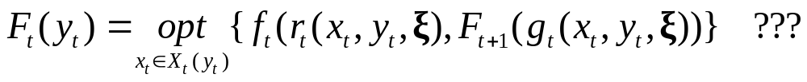
DP – finite horizon, stochastic models
Random return & transition - Underlying Program:

Slide 77
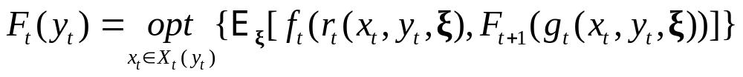
DP – finite horizon, stochastic models
Random return & transition - Underlying Program:
Expected Objective (EO) Deterministic Reformulation:

Slide 78
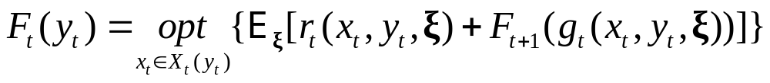
DP – finite horizon, stochastic models
Random return & transition - Underlying Program:
Expected Objective (EO) Deterministic Reformulation:
Additive f_{t} :

Slide 79
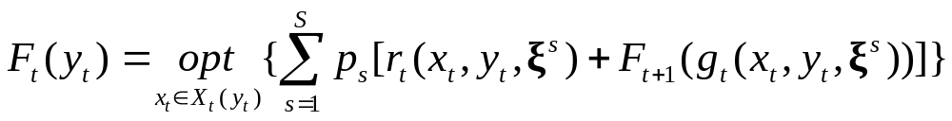
DP – finite horizon, stochastic models
Random return & transition - Underlying Program:
Expected Objective (EO) Deterministic Reformulation:
Additive f_{t} :
Discrete distribution of ξ:

Slide 80
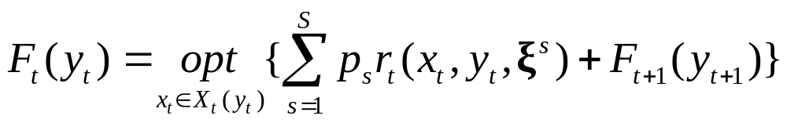
DP – finite horizon, stochastic models
Random return:
Typical applications:
All types of allocation (portfolio related problems,
farming, project management, assignment etc.)
Generally: uncertain immediate gain from a decision.

Slide 81
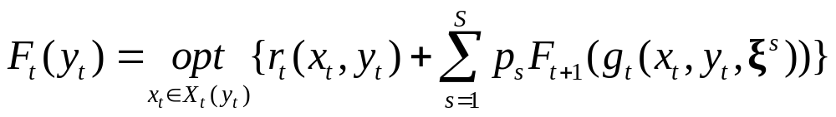
DP – finite horizon, stochastic models
Random transition:
Typical applications:
All types of games (market related decisions,
bidding strategy etc.)
Generally: uncertain future state resulting from a decision
(immediate return often zero).

Slide 82
DP – finite horizon, stochastic models
More about discrete distribution of ξ:

Slide 83
DP – finite horizon, stochastic models
More about discrete distribution of ξ:
Probability conditioned by stage and state:

Slide 84
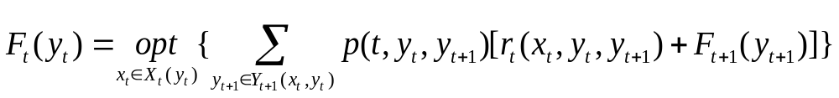
DP – finite horizon, stochastic models
More about discrete distribution of ξ:
Probability conditioned by stage and status:
Probability related to future state:

Slide 85
Stochastic Optimization Example
A game follows these rules: you can throw a fair dice up to 4 times. Each time you can cash twice the number up and finish or continue (not after last trial). Use SDP to find:
Optimal playing strategy
Optimal gain per game
Suggest a “fair” price for the game.
Progressive model with random state = number up:
y₁
y₂
y₄
1
2
4
4
5

Slide 86
Stochastic Optimization Example
Example: game
DP Model:
1. Stages stage = trial t ∈ {1 … 4 }
2. States state y_{t} = random number up
3. Decisions {Take money, Continue}
4. Transition function g_{t}(T ,y_{t}) = (5,1), t =1…4
g_{t}(C ,y_{t}) = (t+1,y_{t+1}), t =1…3
5. Initial state random y₁
6. Functional equation

Slide 87
T | y_{t} | T | C | F_{t} | [F_{t}]
4 | 1 2 3 4 5 6 | 2 4 6 8 10 12 | - - - - - - | 2 4 6 8 10 12 | 7
3 | 1 2 3 4 5 6 | 2 4 6 8 10 12 | 7 7 7 7 7 7 | 7 7 7 8 10 12 | 8.5
2 | 1 2 3 4 5 6 | 2 4 6 8 10 12 | 8.5 8.5 8.5 8.5 8.5 8.5 | 8.5 8.5 8.5 8.5 10 12 | 9.33
1 | 1 2 3 4 5 6 | 2 4 6 8 10 12 | 9.33 9.33 9.33 9.33 9.33 9.33 | 9.33 9.33 9.33 9.33 10 12 | 9.89
Table
solution:

Slide 88
Optimal strategy:
Optimal expected gain per game = (9.89 - price)
Fair price per game = 10 (?)
Trial | Action
1 | Cash 5,6 otherwise continue
2 | Cash 5,6 otherwise continue
3 | Cash 4,5,6 otherwise continue
4 | Cash

Slide 89
Stochastic Optimization Example
Egg dropping problem – random scenario
Assumption: critical floor C is random with some distribution over integers from [0,h]
h = height of the building (number of floors)
n = number of eggs available
k = number of floors to be checked

Slide 90
Stochastic Optimization Example
Egg dropping problem – random scenario
Randomness is present in the transition function: after dropping an egg at floor x when solving an (n,k) problem we either move to:
stage (n -1,x -1) if egg breaks or
stage (n,k -x) if egg doesn’t break
We choose EO reformulation – we minimize expected number of trials:
R(n,k) = minimum expected number of trials to solve a problem of the size (n,k)

Slide 91
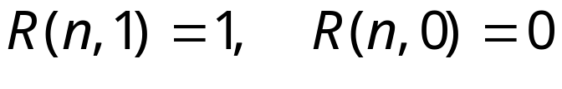
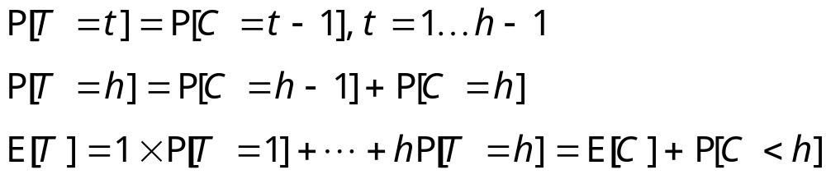
Stochastic Optimization Example
Egg dropping problem – random scenario
Together – degenerate cases:
for n=1 let T be the random number of trials for k =h :
(Similarly for sub-intervals of floors)

Slide 92
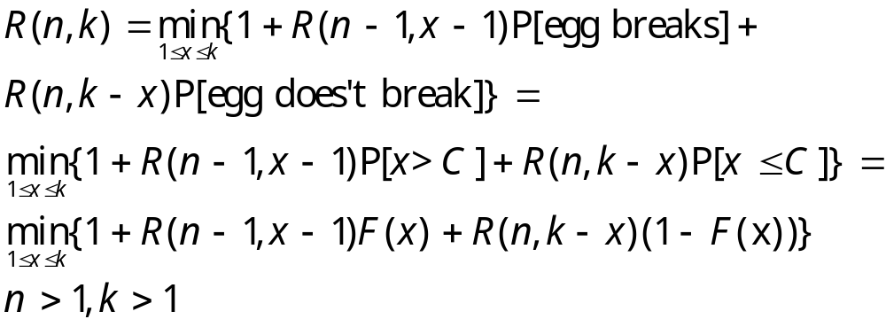
Stochastic Optimization Example
Egg dropping problem – random scenario
Nondegenerate cases:
Where F is the cdf of C (conditional for given interval)

Slide 93
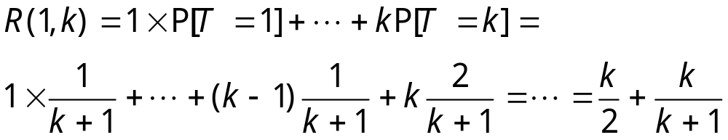
Stochastic Optimization Example
Egg dropping problem – random scenario
For simplicity we consider uniform distribution on [0,h]
Then:

Slide 94
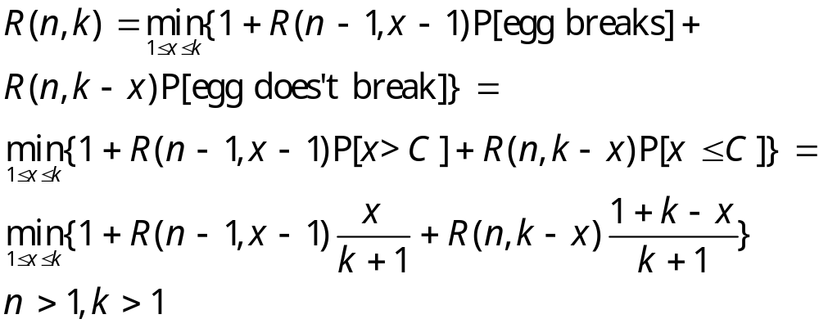
Stochastic Optimization Example
Egg dropping problem – random scenario
For simplicity we consider uniform distribution on [0,h]
Then:

Slide 95
Stochastic Optimization Example
Egg dropping problem – random scenario
Results for the (2,8) problem:
R(n,k):
1.00 1.67 2.25 2.80 3.33 3.86 4.38 4.89
1.00 1.67 2.00 2.40 2.67 2.86 3.13 3.33
Optimal policy:
1 1 1 1 1 1 1 1
1 1 2 2 2 3 3 3
Simulation for critical floor = 4
Drop from floor 3 : Egg not broken (2,8) policy = 3
Drop from floor 5 : Egg broken (2,8-3) policy+3 = 5
Drop from floor 4 : Egg not broken (1,2-1) policy+3 = 4
Actual number of trials = 3

Slide 96
Stochastic Optimization Example
Objective values and optimal decisions:
>>[f L X] = eggDirectLapl(4,20)
f = 4.4762
L = (Columns 13 through 20)
7.4286 7.9333 8.4375 8.9412 9.4444 9.9474 10.4500 10.9524
4.1429 4.2667 4.3750 4.5294 4.6667 4.7895 4.9000 5.0000
3.8571 3.9333 4.0625 4.1765 4.2778 4.3684 4.4500 4.5238
3.8571 3.9333 4.0000 4.1176 4.2222 4.3158 4.4000 4.4762
X = 1 1 1 1 1 1 1 1 1 1 1 1 1 1 1 1 1 1 1 1
1 1 2 2 2 3 3 3 3 4 4 4 4 5 5 5 5 5 5 6
1 1 2 2 2 3 4 4 4 4 4 5 6 7 7 7 7 7 8 7
1 1 2 2 2 3 4 4 4 4 4 5 6 7 8 8 8 8 8 9

Slide 97
Dynamic Programming
Example application: edit distance
(no optimization, progressive model)
edit distance d (s₁, s₂) of two strings is the minimum number of point mutations required to change s₁ into s₂ or vice versa.
point mutation is either change of a character, insertion of a character, or deletion of a character.
Applications: spelling, file integrity, virus protection, plagiarism, …

Slide 98
Dynamic Programming
Example application: edit distance
(no optimization, progressive model)
edit distance d (s₁, s₂) of two strings is the minimum number of point mutations required to change s₁ into s₂ or vice versa.
point mutation is either change of a character, insertion of a character, or deletion of a character.
Clearly d (s,s) = 0, d (s,’’) = d (’’,s) = |s| where ’’ is the empty string and |s| is the length of s.

Slide 99
Dynamic Programming
Example application: edit distance
(no optimization, progressive model)
edit distance d (s₁, s₂) of two strings is the minimum number of point mutations required to change s₁ into s₂ or vice versa.
point mutation is either change of a character, insertion of a character, or deletion of a character.
Clearly d (s,s) = 0, d (s,’’) = d (’’,s) = |s| where ’’ is the empty string and |s| is the length of s.
Recursion for both strings nonempty:
d (s₁+ch₁, s₂+ch₂) = min{ d (s₁, s₂) + (if ch₁=ch₂ then 0 else 1),
d (s₁+ch₁, s₂) + 1, d (s₁, s₂+ch₂) + 1 }

Slide 100
Dynamic Programming
Example application: edit distance
Example:
- | - | r | u | m
- | 1 | 2 | 3 | 4
r | 5 | 6 | 7 | 8
x | 9 | 10 | 11 | 12

Slide 101
Dynamic Programming
Example application: edit distance
Example:
- | - | r | u | m
- | 1 0 | 2 1 | 3 2 | 4 3
r | 5 1 | 6 | 7 | 8
x | 9 2 | 10 | 11 | 12

Slide 102
Dynamic Programming
Example application: edit distance
Example:
min{1+1,0+0,1+1} = 0
- | - | r | u | m
- | 1 0 | 2 1 | 3 2 | 4 3
r | 5 1 | 6 0 | 7 | 8
x | 9 2 | 10 | 11 | 12

Slide 103
Dynamic Programming
Example application: edit distance
Example:
min{2+1,1+1,0+1} = 1
- | - | r | u | m
- | 1 0 | 2 1 | 3 2 | 4 3
r | 5 1 | 6 0 | 7 1 | 8
x | 9 2 | 10 | 11 | 12

Slide 104
Dynamic Programming
Example application: edit distance
Example:
Mutations: copy r, insert u, change x to m
copy r, change x to u, insert m
- | - | r | u | m
- | 1 0 | 2 1 | 3 2 | 4 3
r | 5 1 | 6 0 | 7 1 | 8 2
x | 9 2 | 10 1 | 11 1 | 12 2

Slide 105
Dynamic Programming
Example application: edit distance is a progressive model
1 2 3 4 5 6 7 8 9 10 11 12
- | - | r | u | m
- | 1 0 | 2 1 | 3 2 | 4 3
r | 5 1 | 6 0 | 7 1 | 8 2
x | 9 2 | 10 1 | 11 1 | 12 2

Slide 106
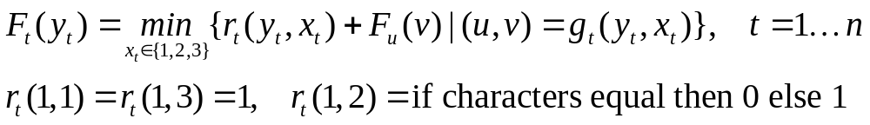
Dynamic Programming
Example application: edit distance
DP Model:
1. Stages stage = table entry t ∈ {1 … n = (|s₁|+1)(|s₂|+1)}
2. States state value irrelevant (=1, one state per stage)
3. Decisions {1, 2, 3} where 1=North, 2=N.W., 3=West
4. Transition function g_{t}(x_{t} ,y_{t}) = (u,v), u = stage, v = state
g_{t}(y_{t} ,1) = (t – |s₂| – 1, 1); g_{t}(y_{t} ,2) = (t – |s₂| – 2, 1);
g_{t}(y_{t} ,3) = (t – 1, 1)
5. Initial state irrelevant (=1)
6. Functional equation

Slide 107
Dynamic Programming
Example application: edit distance
>> d = editdistance('dalmacie','decimalka')
d = 6
>> d = editdistance('This is an original text to be tested for plagiarism','And this is a modified text to avoid plagiarism issue')
d = 30
Thank you !

